Slide 1
ENSE 471, Milestone 2
March 13th, 2019

Slide 2
!Cool
Taylen Jones
Joseph Bello
Brandon Clarke

Slide 3
Brainstorm #1
Current Students -> Taylen
Future Students -> Brandon
Faculty and Staff -> Joseph
Constraints
We didn’t incorporate any constraints into our first ideations
We won’t be able to make it completely our own based on the layout/design constraints of cascade serve

Slide 4
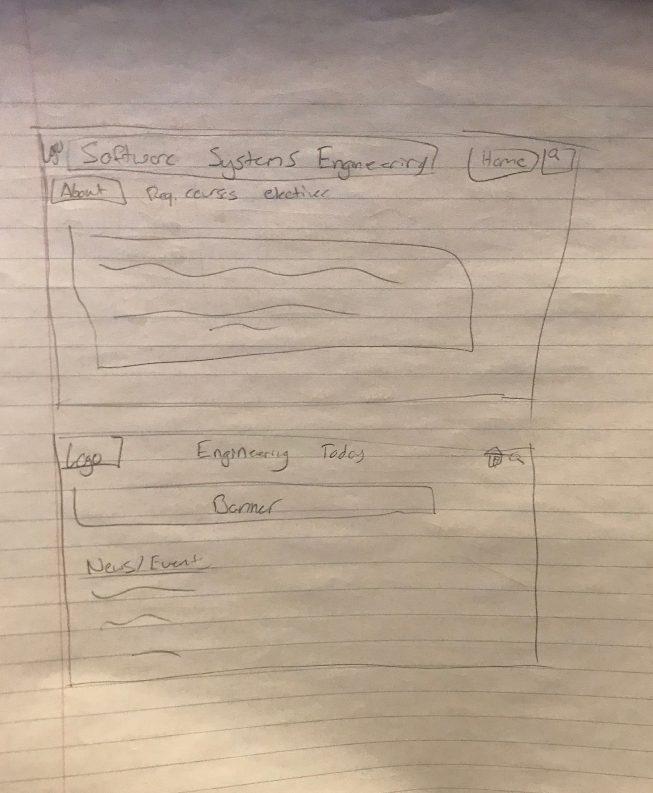
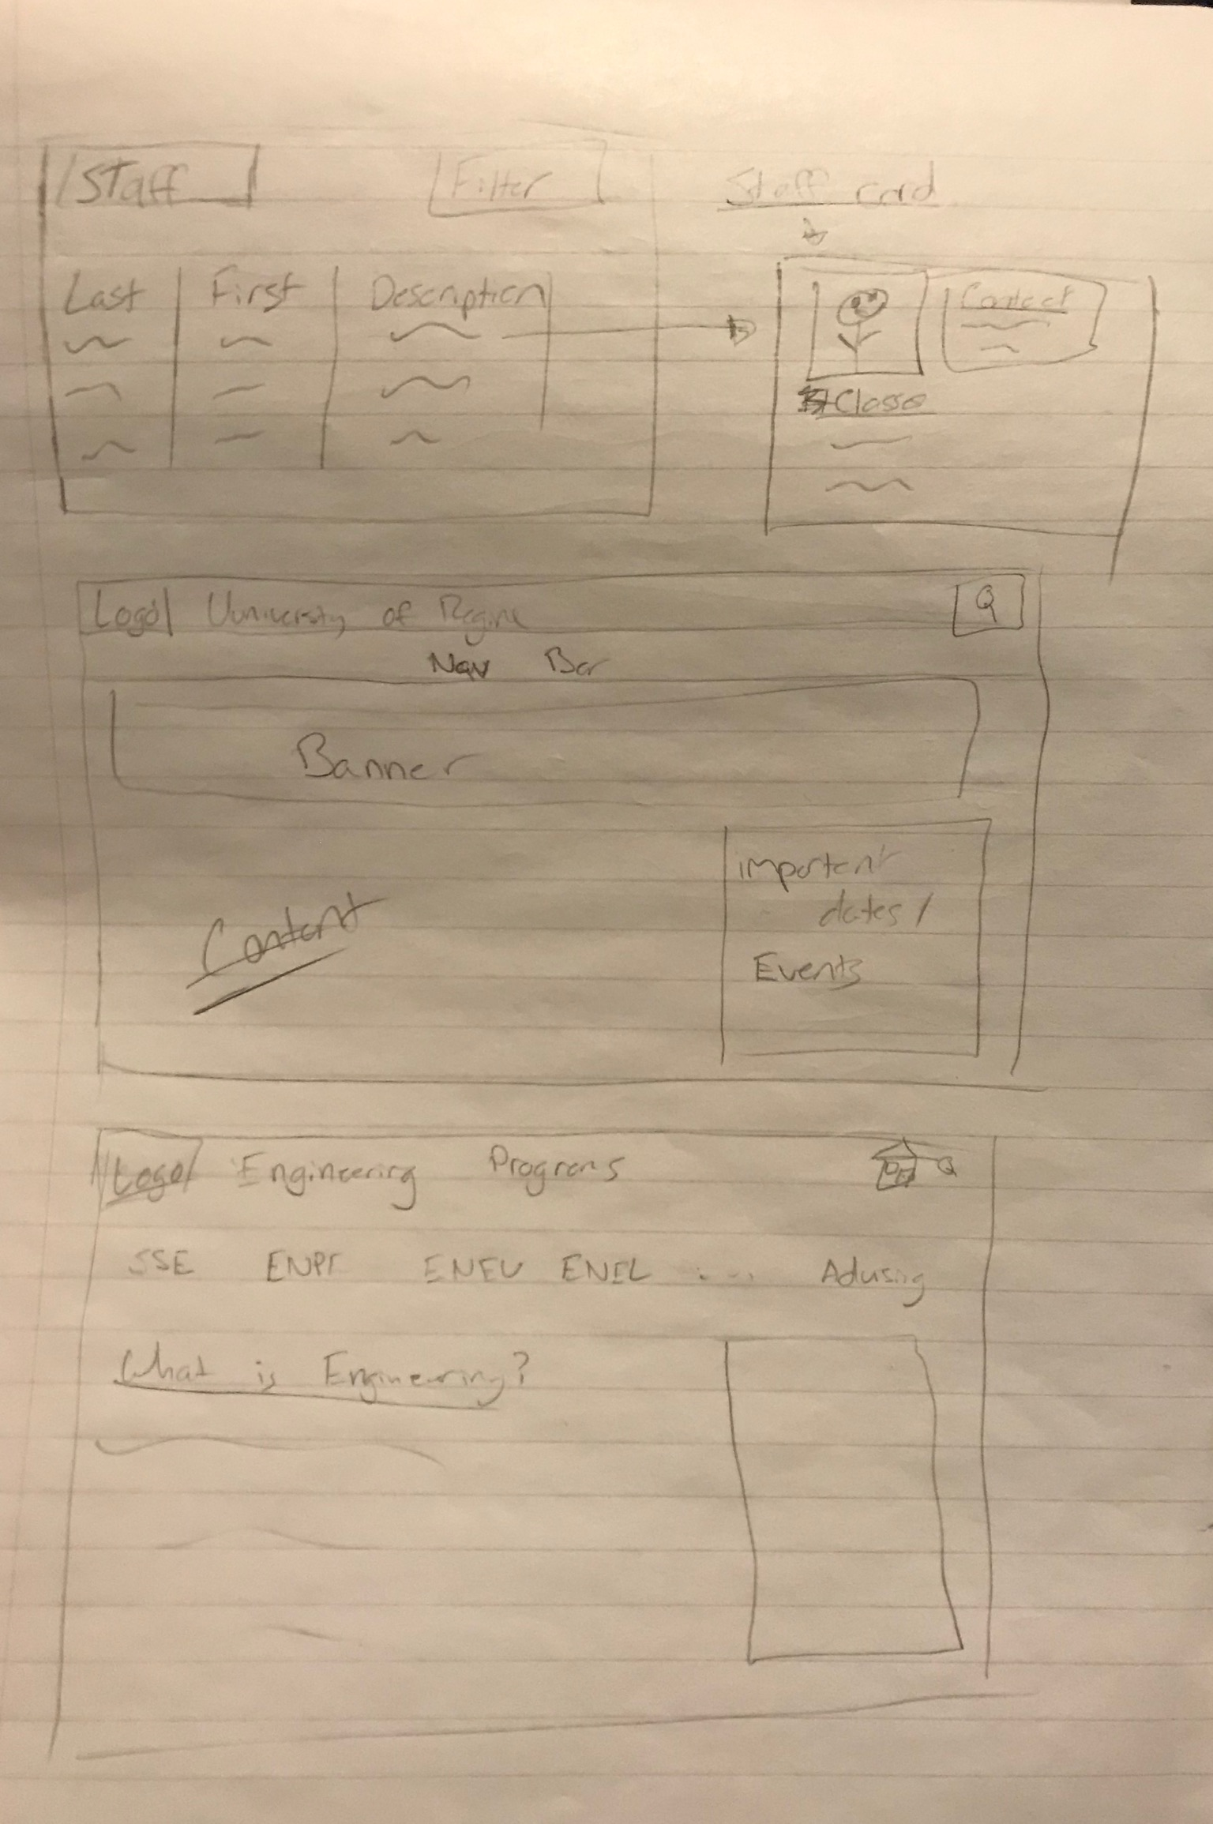
Ideations

Slide 5
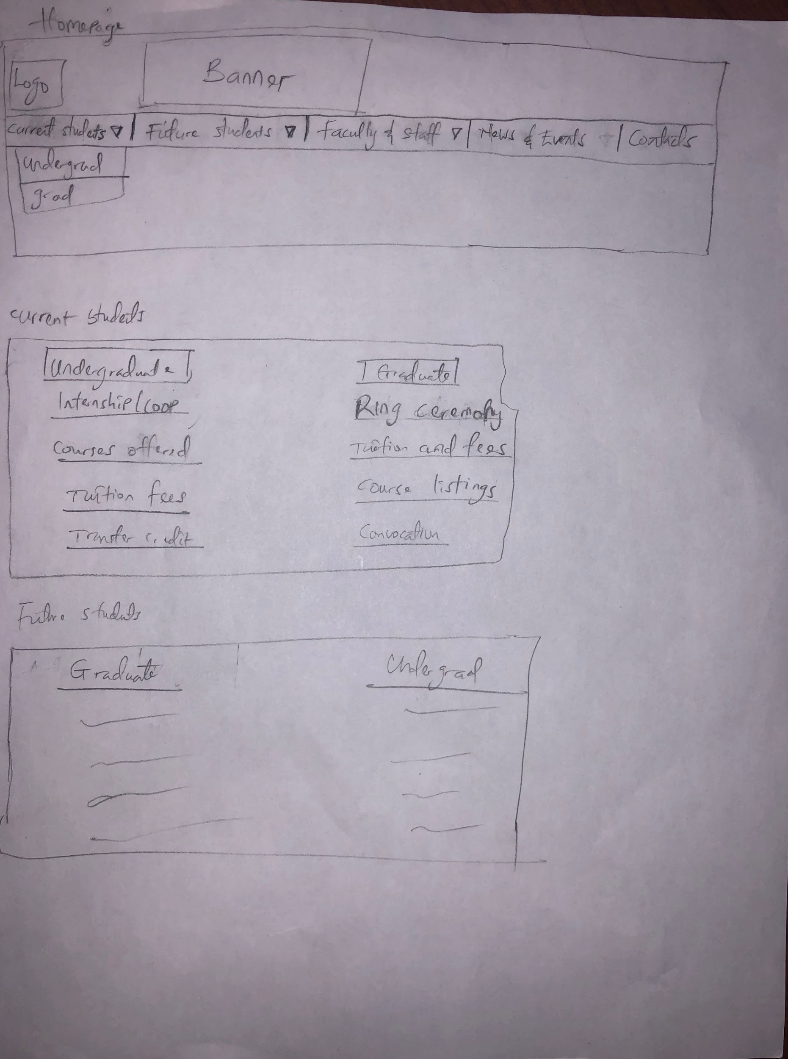
Ideations

Slide 6
Evaluate #1
Current Student Feedback
Hard to navigate/lots of text
No social media links
Specific information can be hard to find
Would like if specific pages loaded based on the user that is logged in
Faculty/Staff Feedback
New tabs shouldn’t open when some buttons are clicked
Keep the content, but reorganize
Maybe have a logo for the engineering faculty
Do the different target customers have the same experience?
Try to compact information i.e. Provide a lot of information without making it overwhelming

Slide 7
Evaluate #1
Future Student Feedback
No info on classes
No info on tuition costs
No info on admission requirements
No info on finances and scholarships

Slide 8
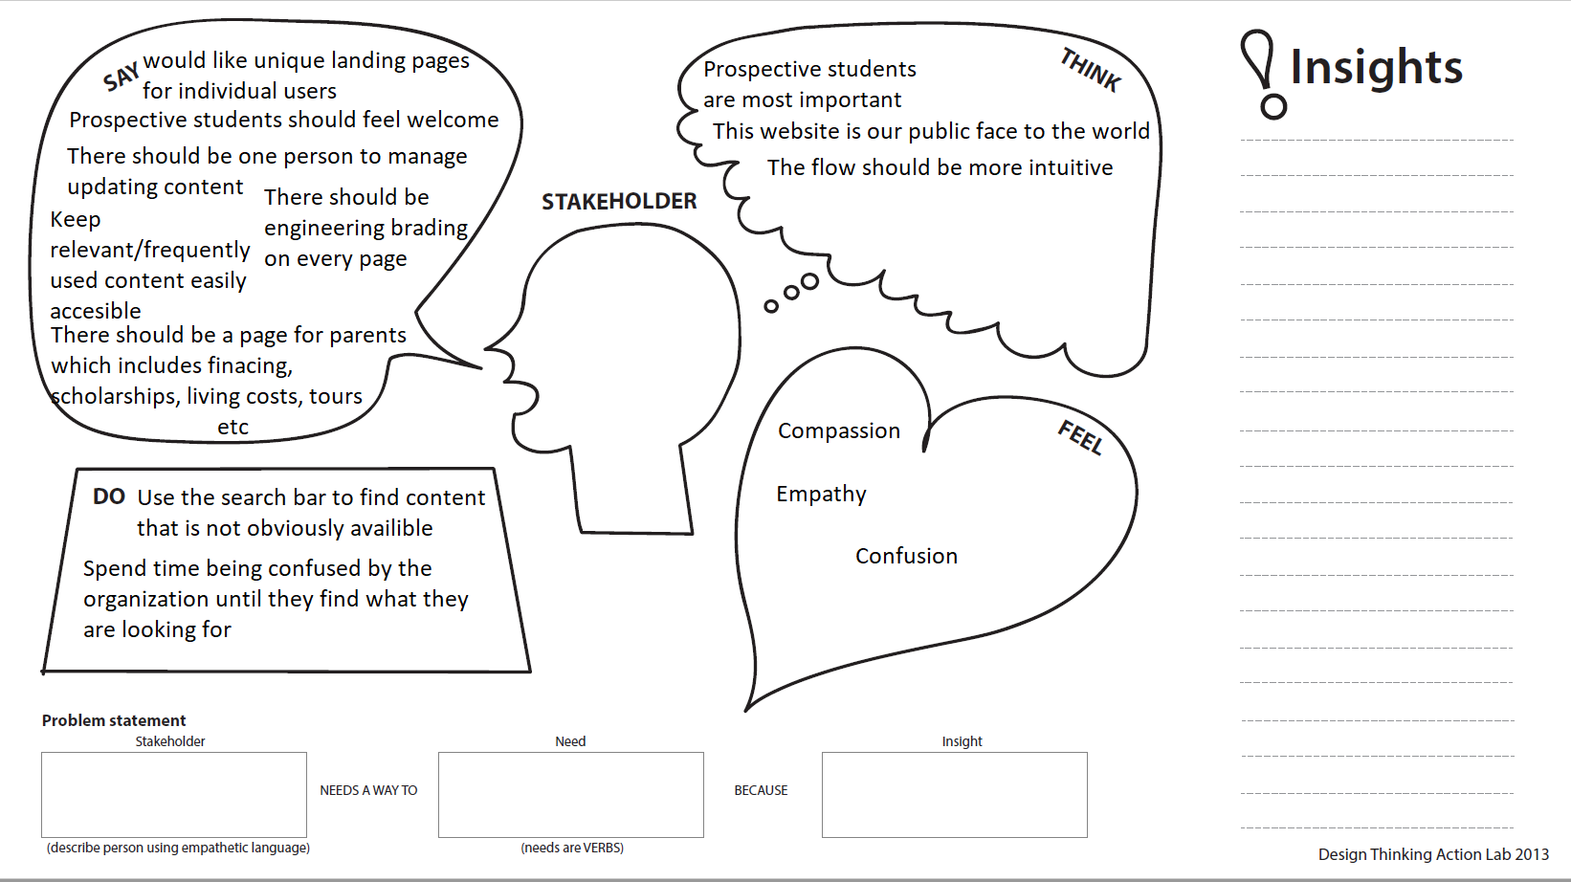
Empathy Map - Future Students

Slide 9
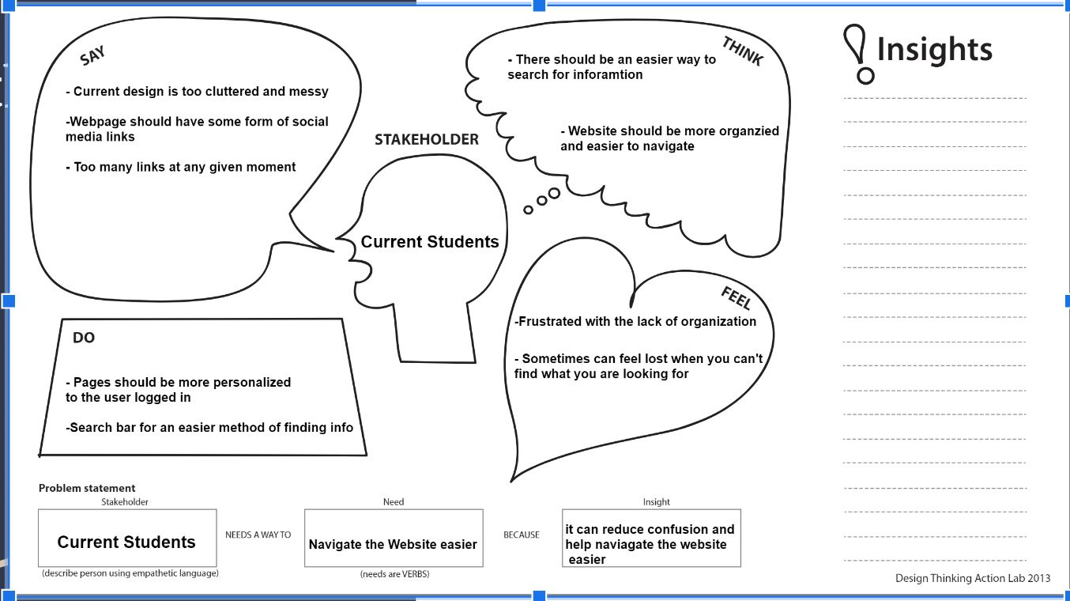
Empathy Map - Current Students

Slide 10
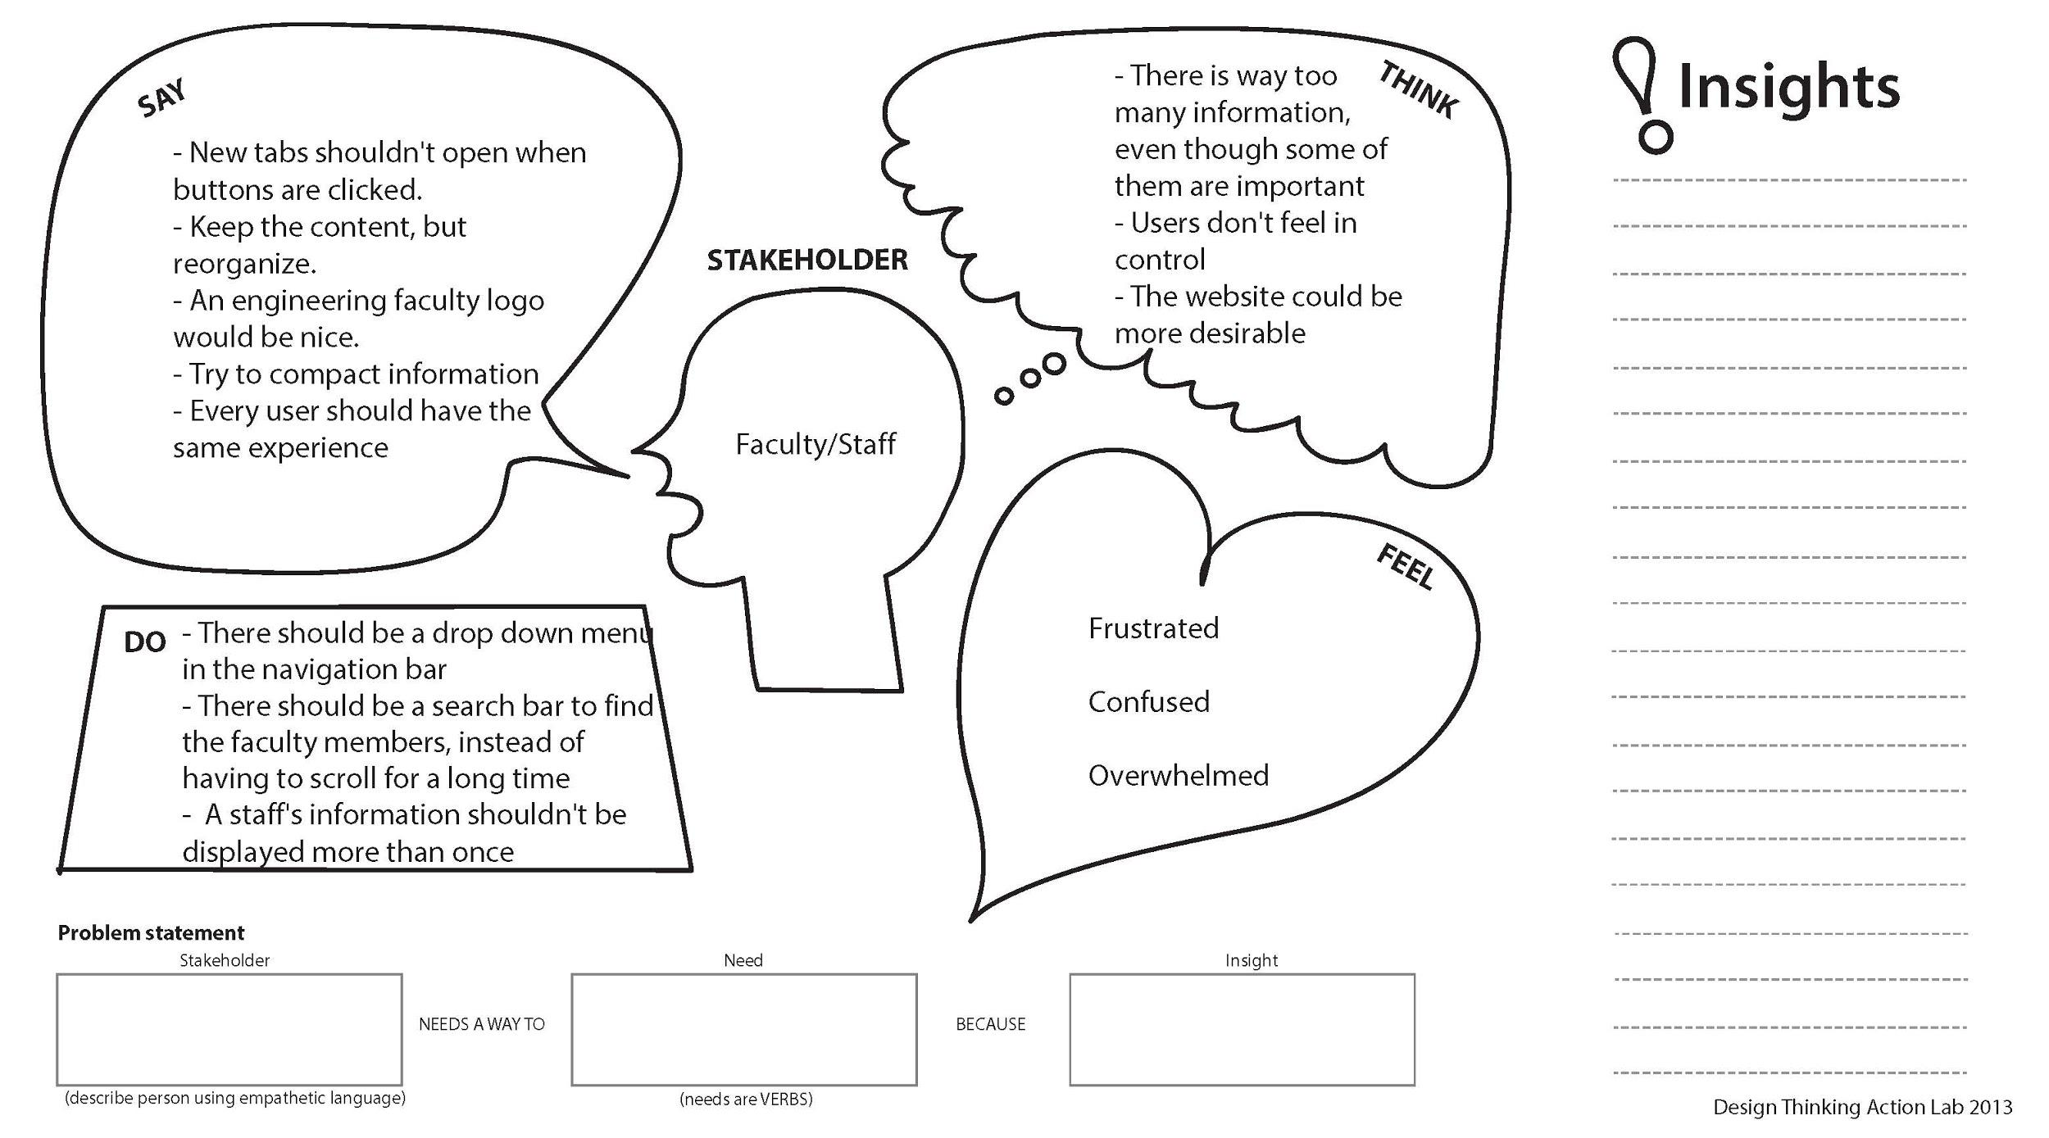
Empathy Map - Faculty / Staff

Slide 11
Brainstorm #2

Slide 12
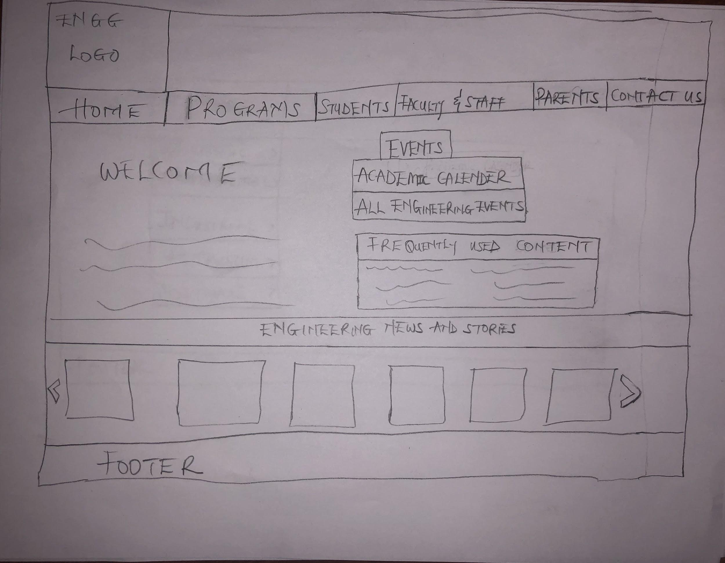
Homepage

Slide 13
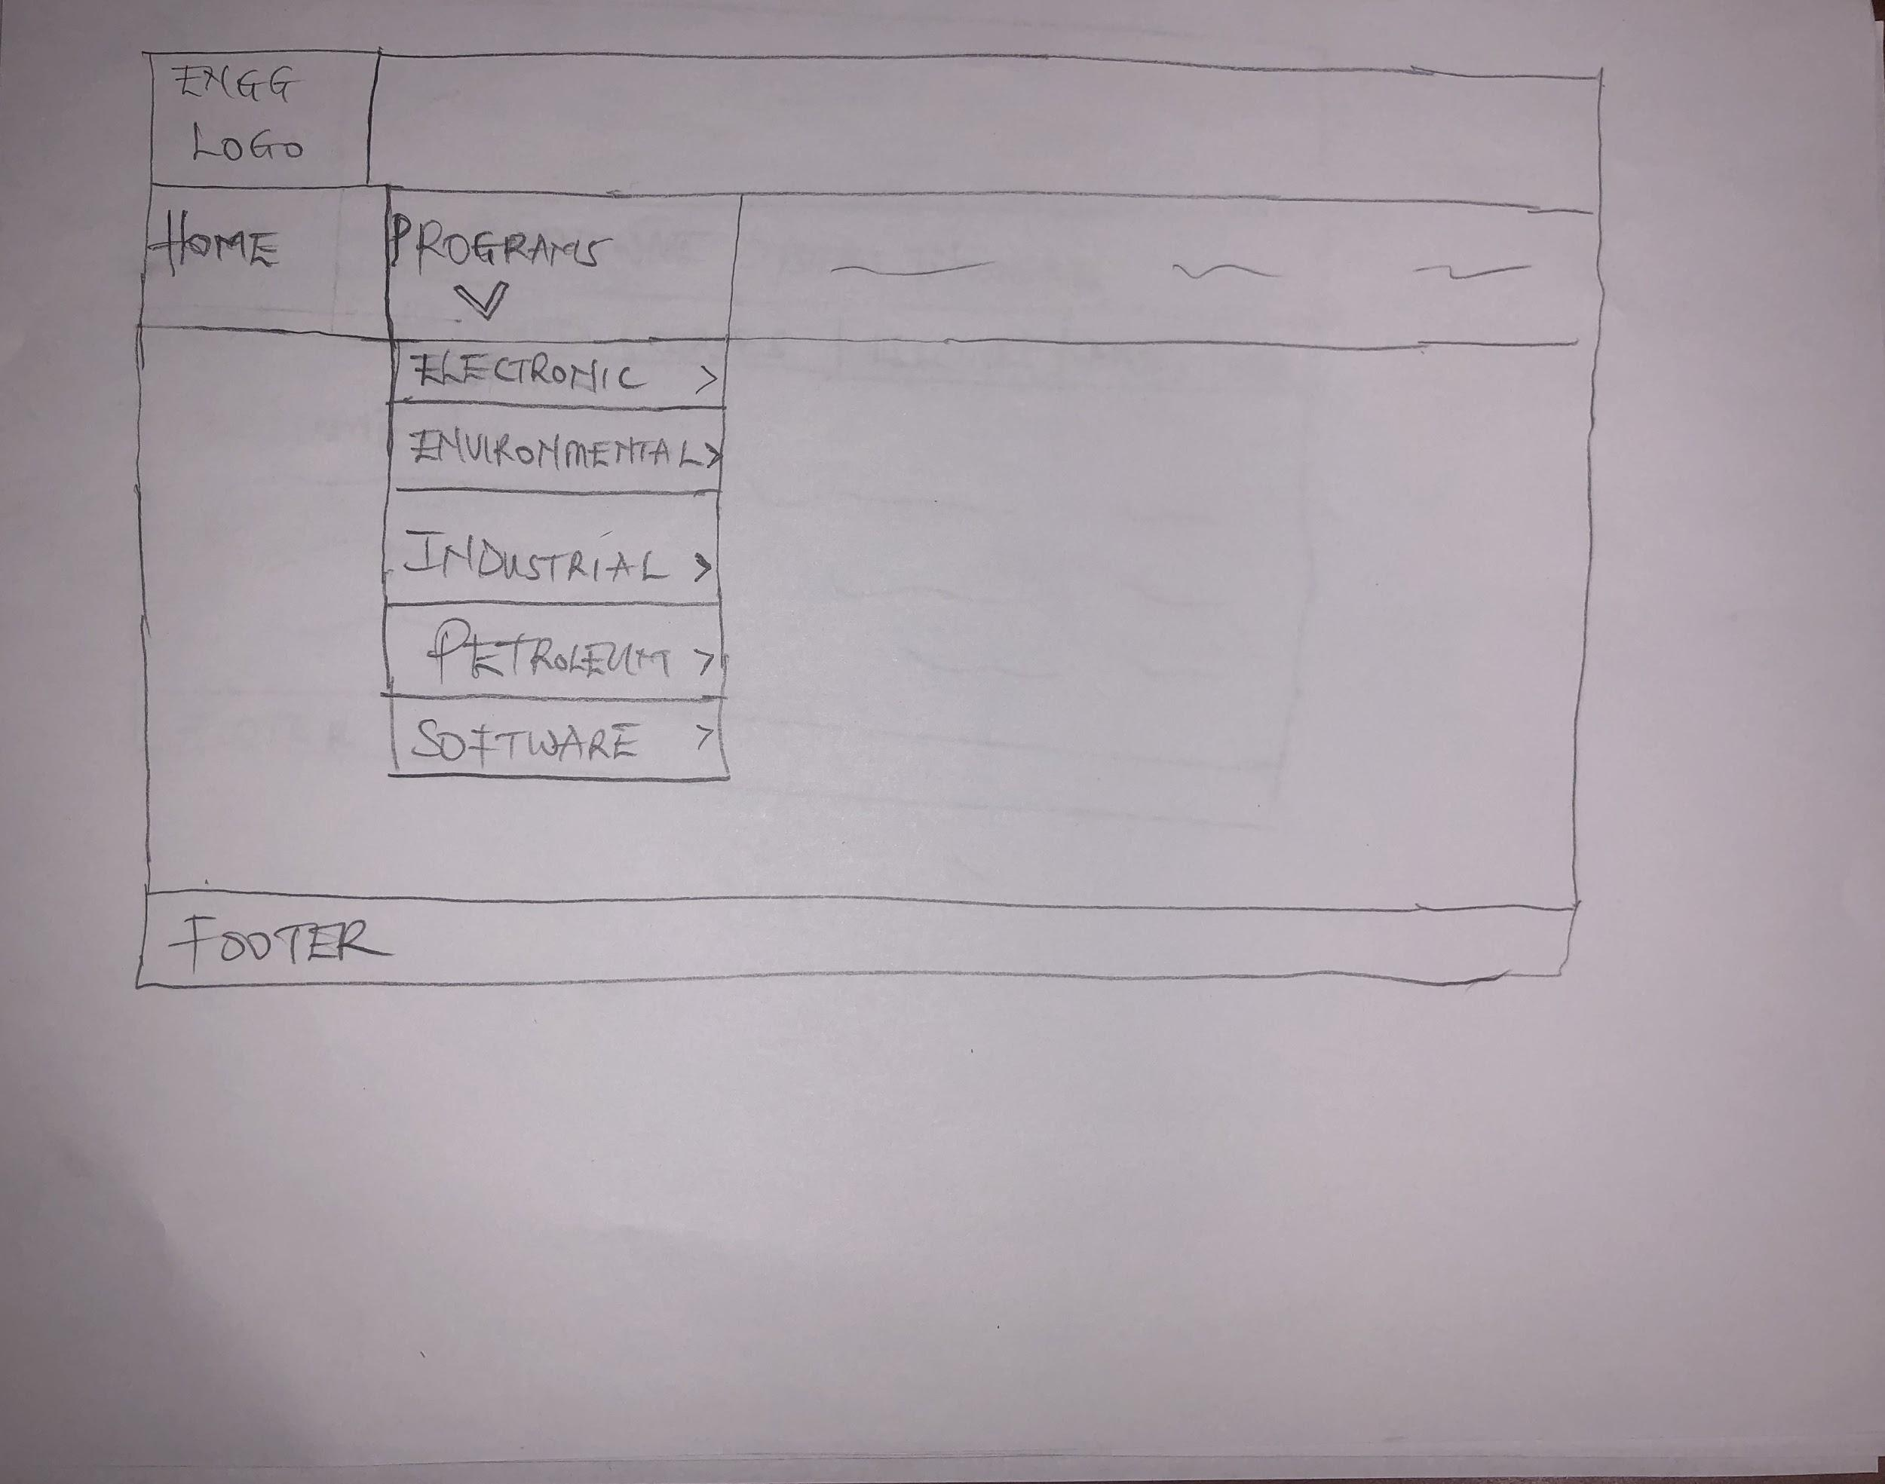
Programs

Slide 14
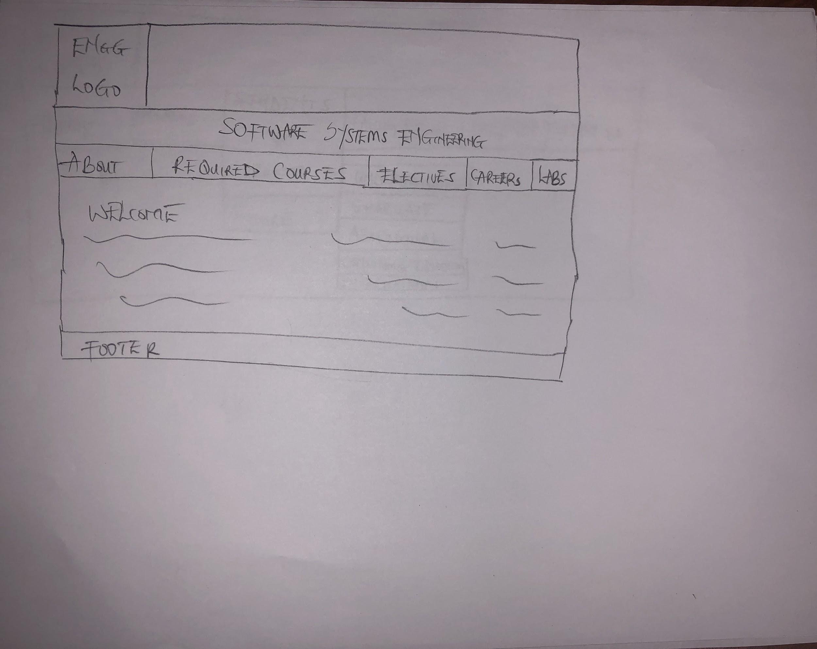
Program

Slide 15
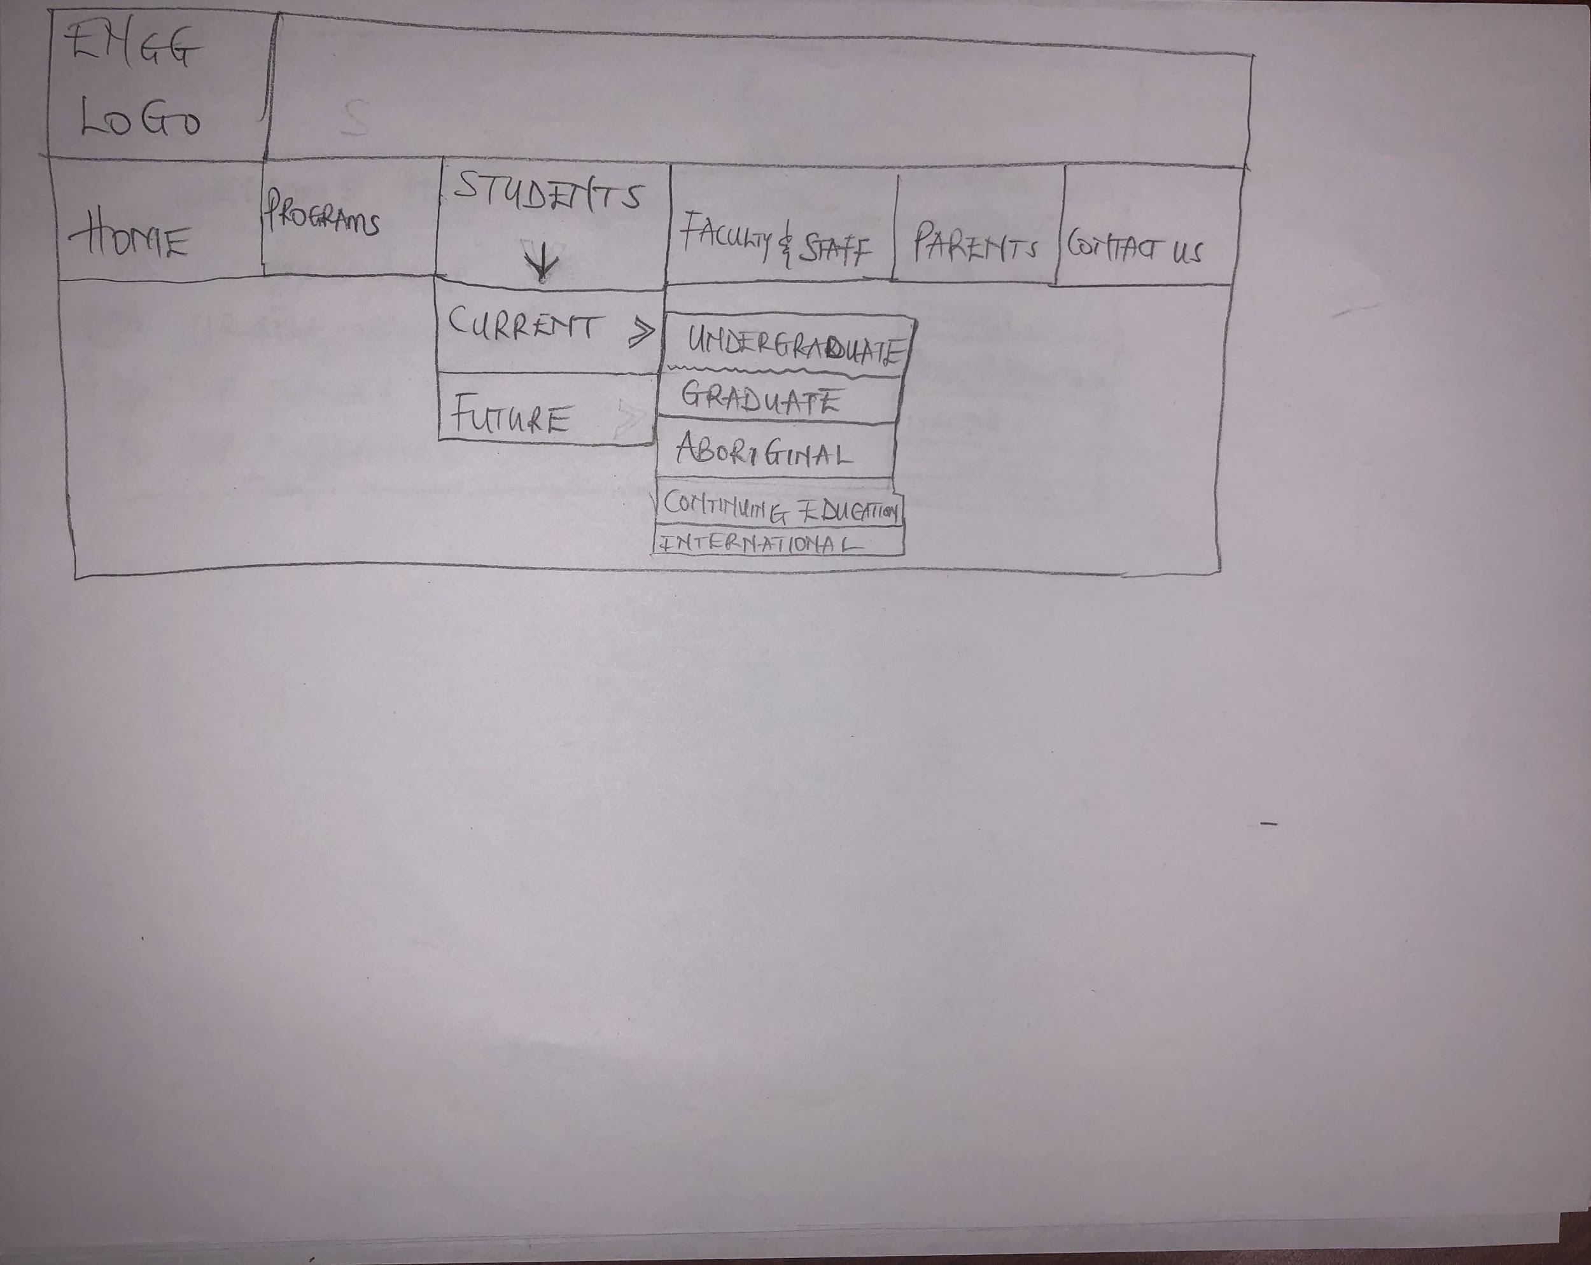
Students

Slide 16
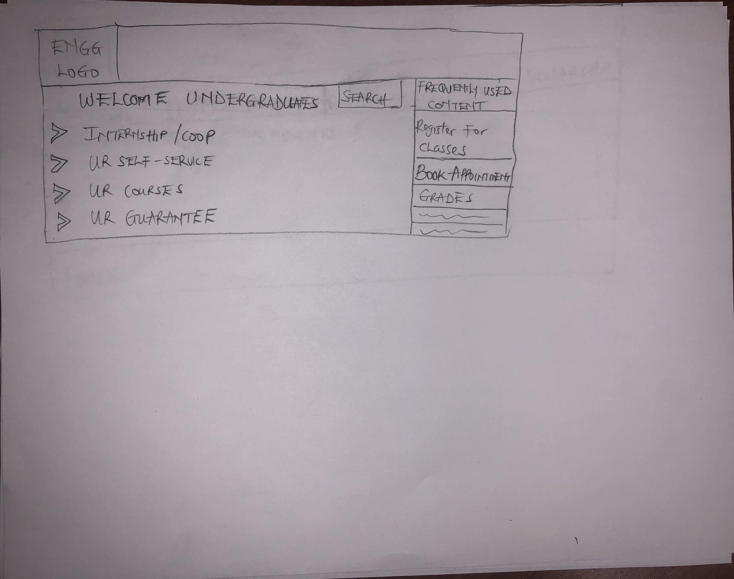
Current Students

Slide 17
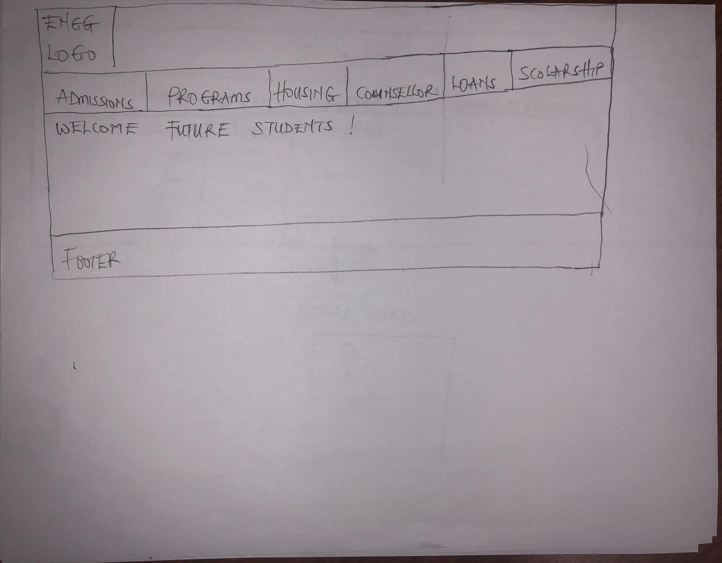
Future Students

Slide 18
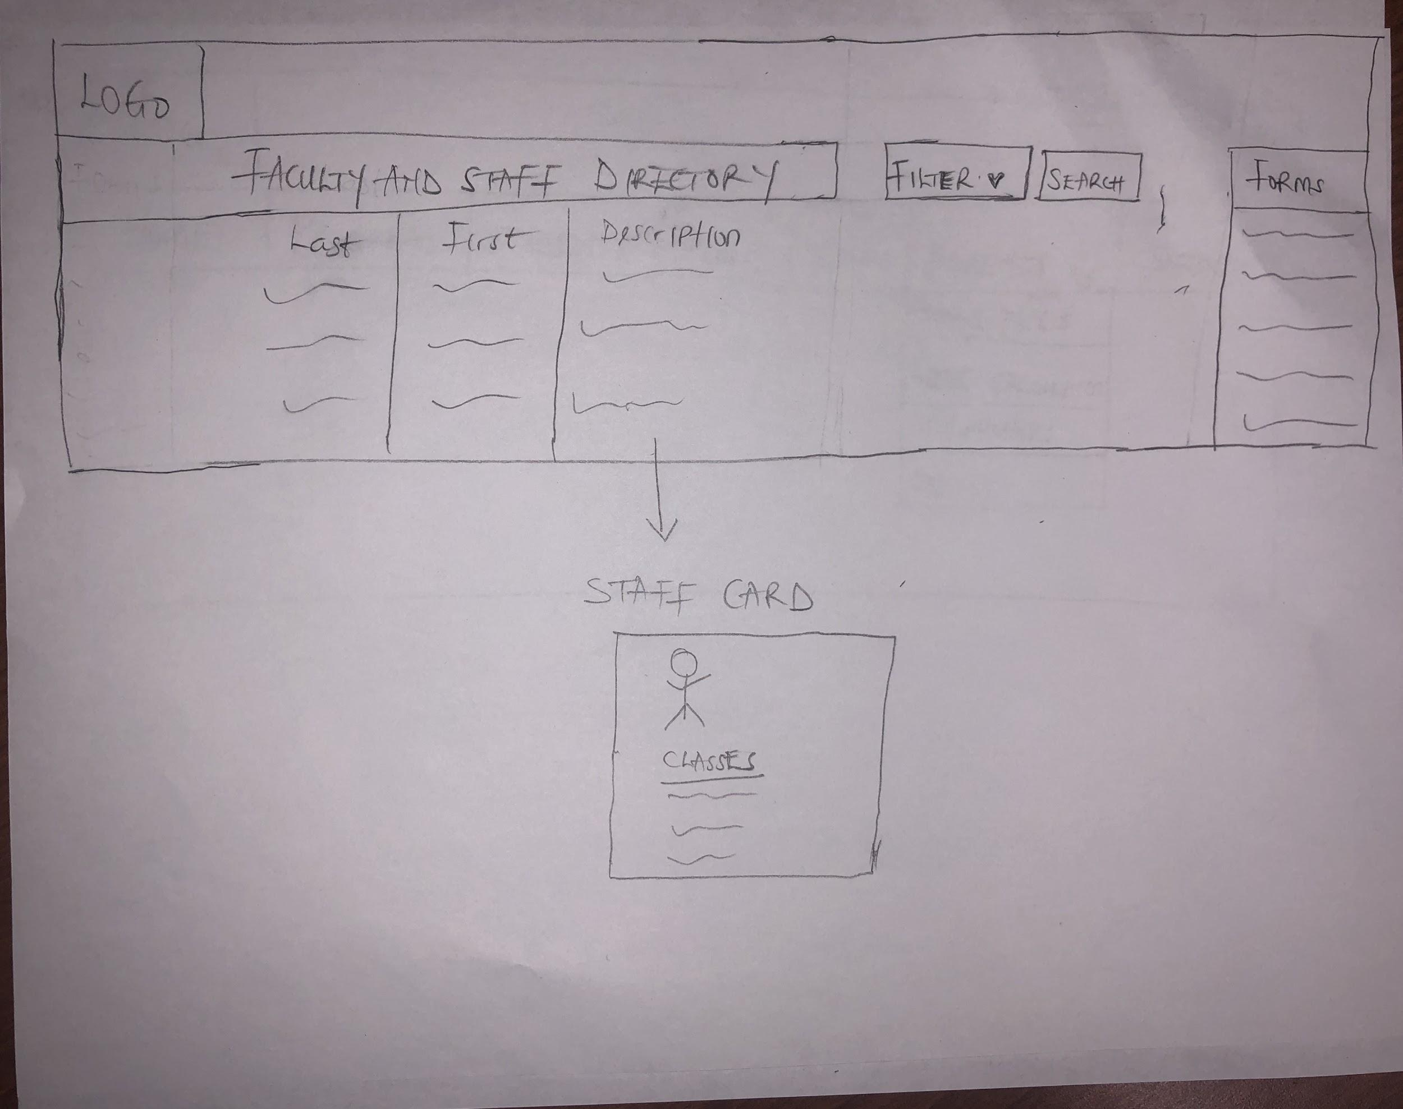
Faculty and Staff

Slide 19
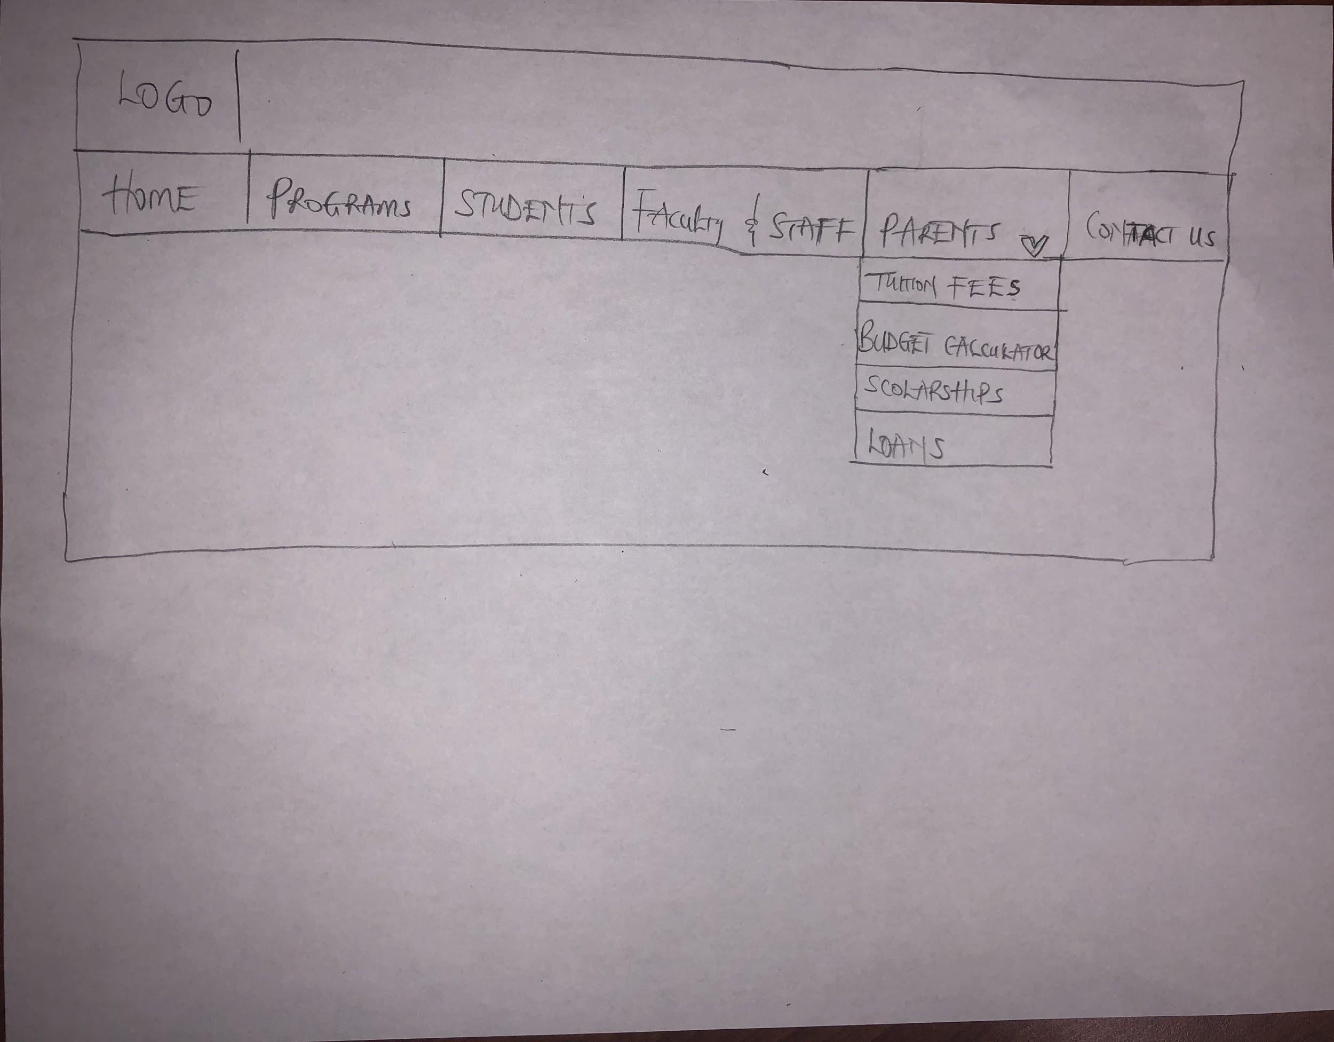
Parents

Slide 20
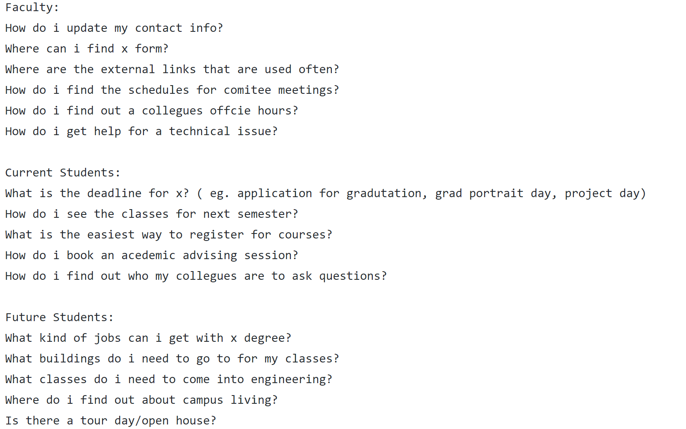
Brainstorm #2

Slide 21
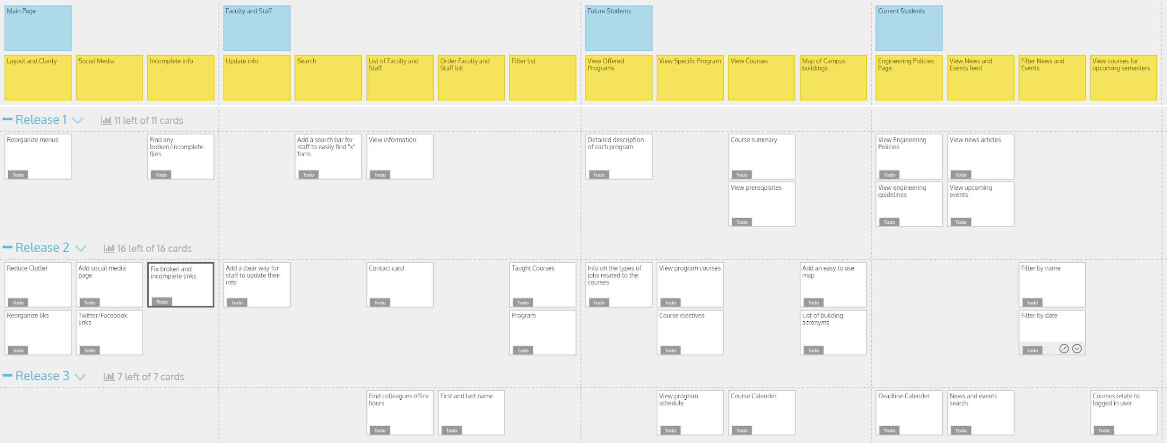
Updated USM

Slide 22
Github Review
Github Link: https://github.com/jones35t/NotCool

Slide 23
Group Reflection

Slide 24
HOW DID YOU FEEL ABOUT THIS MILESTONE? We were able to efficiently work together as a group. The fact that each group member had a target customer, made things easier. | WHAT DID YOU LEARN ABOUT YOURSELF? We learnt a lot about group work, cooperation, delegation, and how important it is to listen to target customers as it helps us to trim our ideations and focus on what's important.
HOW WILL YOU USE WHAT YOU HAVE LEARNED GOING FORWARD? We will continue to listen equally to the ideas of others and that of our target customers. | WHAT “STUFF AND THINGS” RELATED TO THIS MILESTONE WOULD YOU WANT HELP WITH? We weren’t really clear about how to fit our questions into the story map, but we tried to figure it out.

Slide 25
Questions?

